Slide 1

KRISHNA CHAITANYA INSTITUTE OF TECHNOLOGY AND SCIENCES
(Approved by AICTE, New Delhi & Affiliated to JNTU Kakinada)
A
Presentation on
Hand Gesture Classification Using Convolutional Neural Networks and OpenCV
Submitted for the Partial fulfilment
Of
BACHELOR OF TECHNOLOGY
In
COMPUTER SCIENCE & ENGINEERING
By
Sk. Arjumand Banu 21JU1A0520
V. Anjali 21JU1A0511
P. Anjali Devi 21JU1A0514
S. Anjali 21JU1A0512
B. Chandana 21JU1A0530
Under the guidance of
Dr. J.V. Anil Kumar M.Tech, Ph.D.
Professor & HOD

Slide 2
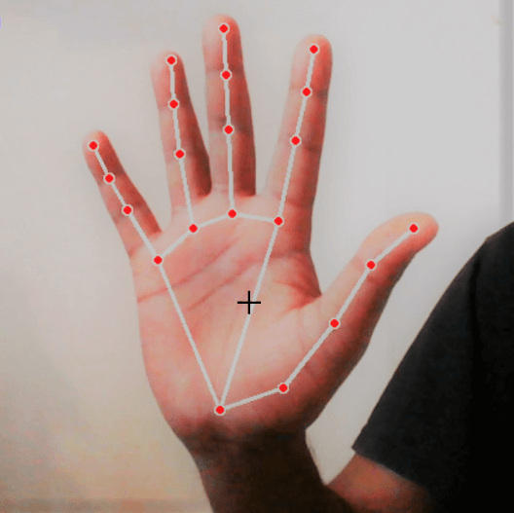
Hand Gesture Classification using Convolutional Neural Networks and OpenCV
Presented by:
Shaik Arjumand Banu - 21JU1A0520
Venna Anjali - 21JU1A0511
Pallapu Anjali Devi - 21JU1A0514
Singareddy Anjali - 21JU1A0512
Byragani Chandana - 21JU1A0530

Slide 3

CONTENTS
Introduction to Gesture Recognition
Literature Review Summary
System Analysis
System Requirements
System Design Overview
Software Environment
Implementation
Testing & Validation
Sample Screenshots
Conclusion

Slide 4
INTRODUCTION
Gesture recognition is a technology that interprets human body movements—especially hand gestures—using computer vision and machine learning.
It enables touchless control, making interactions more natural, intuitive, and accessible, especially in smart systems.
Deep learning models, especially CNNs, significantly improve gesture recognition accuracy by learning patterns from vast datasets.
OpenCV offers powerful real-time image and video processing capabilities essential for gesture detection and tracking.
This system supports real-time recognition, allowing immediate system response to user gestures.

Slide 5
Abstract of the Project
This project presents a gesture recognition system powered by deep learning and OpenCV, designed to detect and interpret human gestures in real time.
Integrates Convolutional Neural Networks (CNNs) with OpenCV to recognize human gestures
Detects hand movements, body postures, and facial expressions in real-time.
Processes live video input efficiently to provide instant recognition and response.
Learns from labeled gesture datasets to classify gestures with high accuracy.
Handles video capture, frame processing, filtering, and transformation.
Useful in human-computer interaction, VR/AR, smart home control, healthcare, and gaming.
Can improve accuracy over time through retraining, and easily be extended to new environments or gestures.

Slide 6
Problem Statement & Objectives
Build a smart system that understands human gestures.
CNNs help the system learn from thousands of gesture images and videos.
OpenCV captures live camera input and prepares it for analysis.
The system should respond instantly to hand movements, without delay.
From a thumbs-up to a wave, the system should understand different types of gestures.

Slide 7
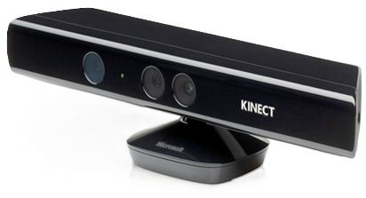
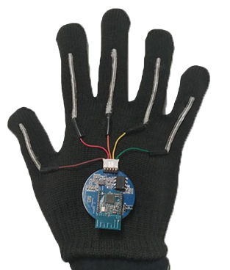
LITERATURE SURVEY
1. Existing Gesture Recognition Systems:
Traditional systems used glove-based or marker-based tracking.
Kinect-based gesture control used in early gaming and UI systems.
Mobile apps with basic gesture-based navigation (e.g., swipe, pinch).
Use of rule-based or static pattern recognition (limited flexibility).
Common examples: Microsoft Kinect, Leap Motion, Google Soli.

Slide 8
2. Drawbacks of Existing Systems:
Require external hardware (Kinect, gloves, sensors).
Limited to predefined gestures (hardcoded).
Poor performance in low lighting or background clutter.
Low adaptability to different hand sizes or skin tones.
High cost, low scalability for common users.

Slide 9
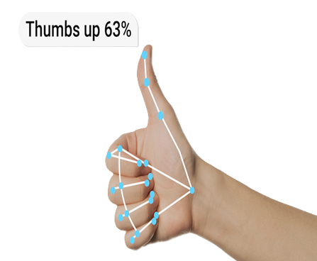
3. How Our System Is Different:
Uses only a webcam or mobile camera — no extra devices needed.
Built with CNN-based deep learning, adaptable to new gestures.
Processes live video feed in real time using OpenCV.
Works across varied lighting conditions and backgrounds.
Modular and scalable – easy to expand with more gestures.

Slide 10
SYSTEM ANALYSIS
1. Existing System Overview:
Feature | Existing Systems | Our System
Hardware Required | Yes | No
Learning Capability | None (Hardcoded) | CNN (Trainable)
Lighting Dependence | High | Moderate
Real-time Accuracy | Low–Medium | High

Slide 11
2. Proposed System Features:
Uses OpenCV to capture and preprocess real-time video frames.
Convolutional Neural Network (CNN) used for gesture classification.
Modular structure with 4 major components:
Input Capture
Image Preprocessing
Gesture Recognition
Output Mapping
Easy to extend to new gestures by retraining the model.

Slide 12
3. Functional Flow of the System
System initializes camera and begins video capture.
Frames are extracted in real time.
Each frame is:
Resized
Normalized
Converted to grayscale (if needed)
Frame passed into CNN model
Prediction is made
Corresponding gesture action is triggered/displayed.
Start
↓
Initialize Webcam
↓
Capture Frame
↓
Preprocess Frame
↓
CNN Prediction
↓
Map Gesture to Action
↓
Display/Execute Output
↓
Repeat
Fig : Flow Chart

Slide 13
4 . Advantages of Our System:
Hardware Independent : Only requires a standard camera.
Scalable : New gestures can be added through training.
Robust : Performs well in real-world environments.
User-Friendly : No wearables or sensors needed.
Fast : Real-time detection and response.

Slide 14
SYSTEM REQUIREMENTS
Hardware Requirements
Processor : Intel i5 or higher
RAM : Minimum 4 GB / 8GB
Camera : Integrated or external webcam
(720p or higher)
Storage : At least 1 GB free disk space
GPU : For faster CNN training
(NVIDIA GTX series)
Software Requirements
Operating System : Windows 10/11 or Linux-based
OS
Python Version : 3.7 or above
Libraries : OpenCV , NumPy , TensorFlow or
Keras , Matplotlib
IDE : Jupyter Notebook / VS Code /
PyCharm
Others : Webcam access permissions

Slide 15
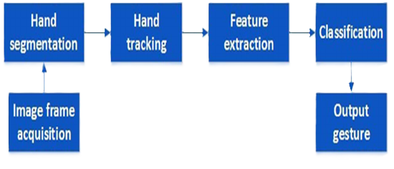
SYSTEM DESIGN
System Design – Overview
High-level design to define system workflow
Divided into Input, Processing, and Output stages
Core components:
Camera input
Preprocessing module (OpenCV)
CNN classifier
Output display/action
Fig : Block Diagram

Slide 16
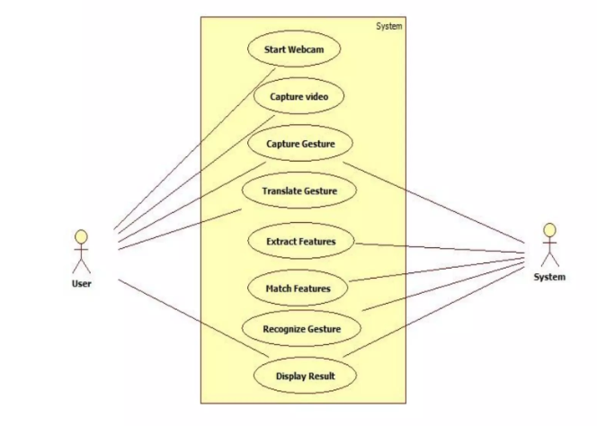
UML Diagram – Use Case Diagram

Slide 17
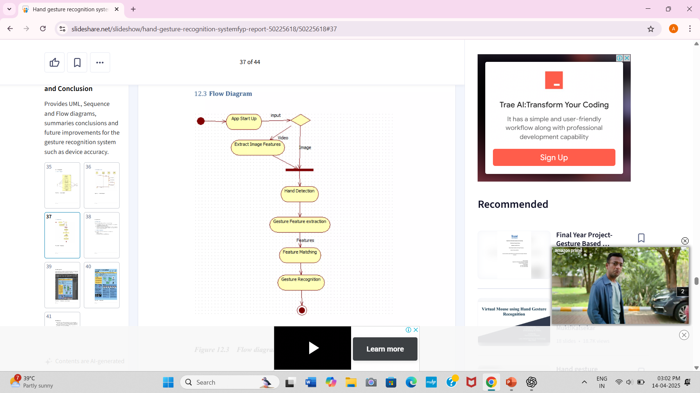
UML Diagram – Activity Diagram

Slide 18
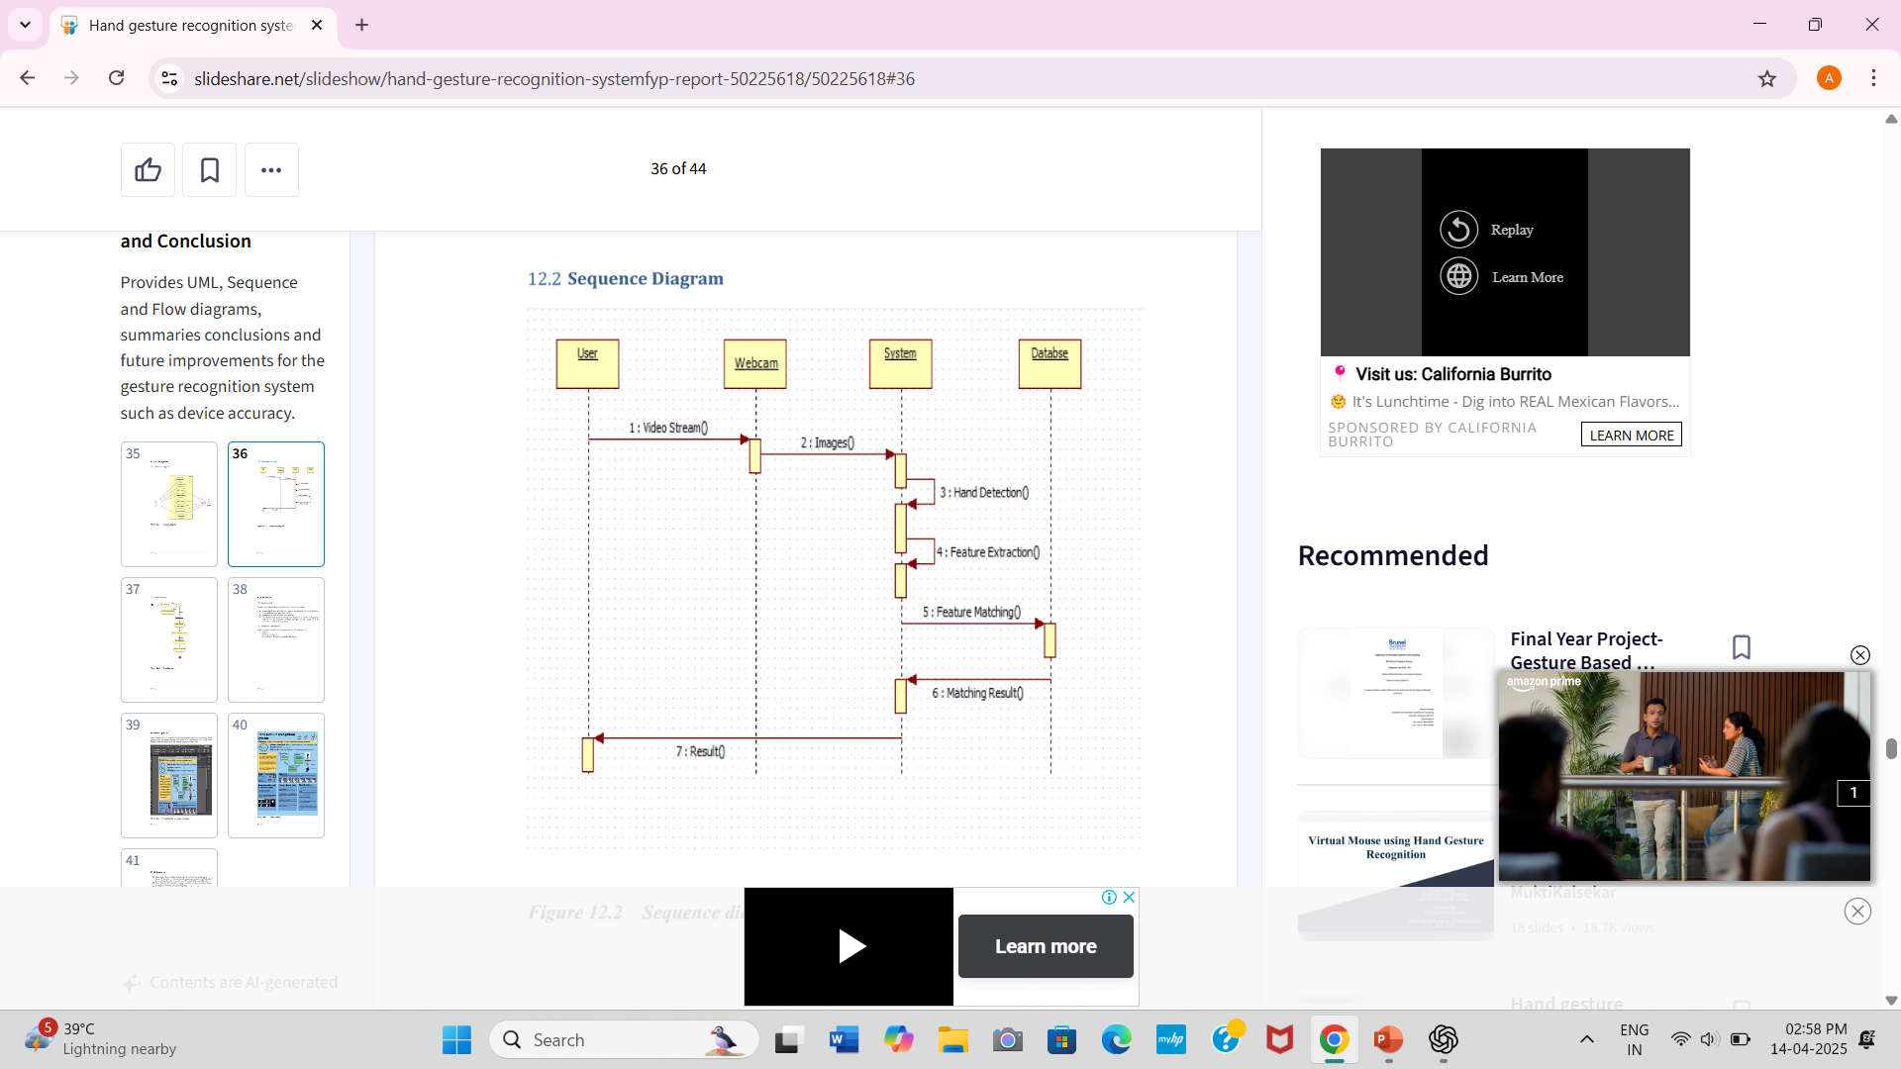
UML DIAGRAM – Sequence Diagram

Slide 19
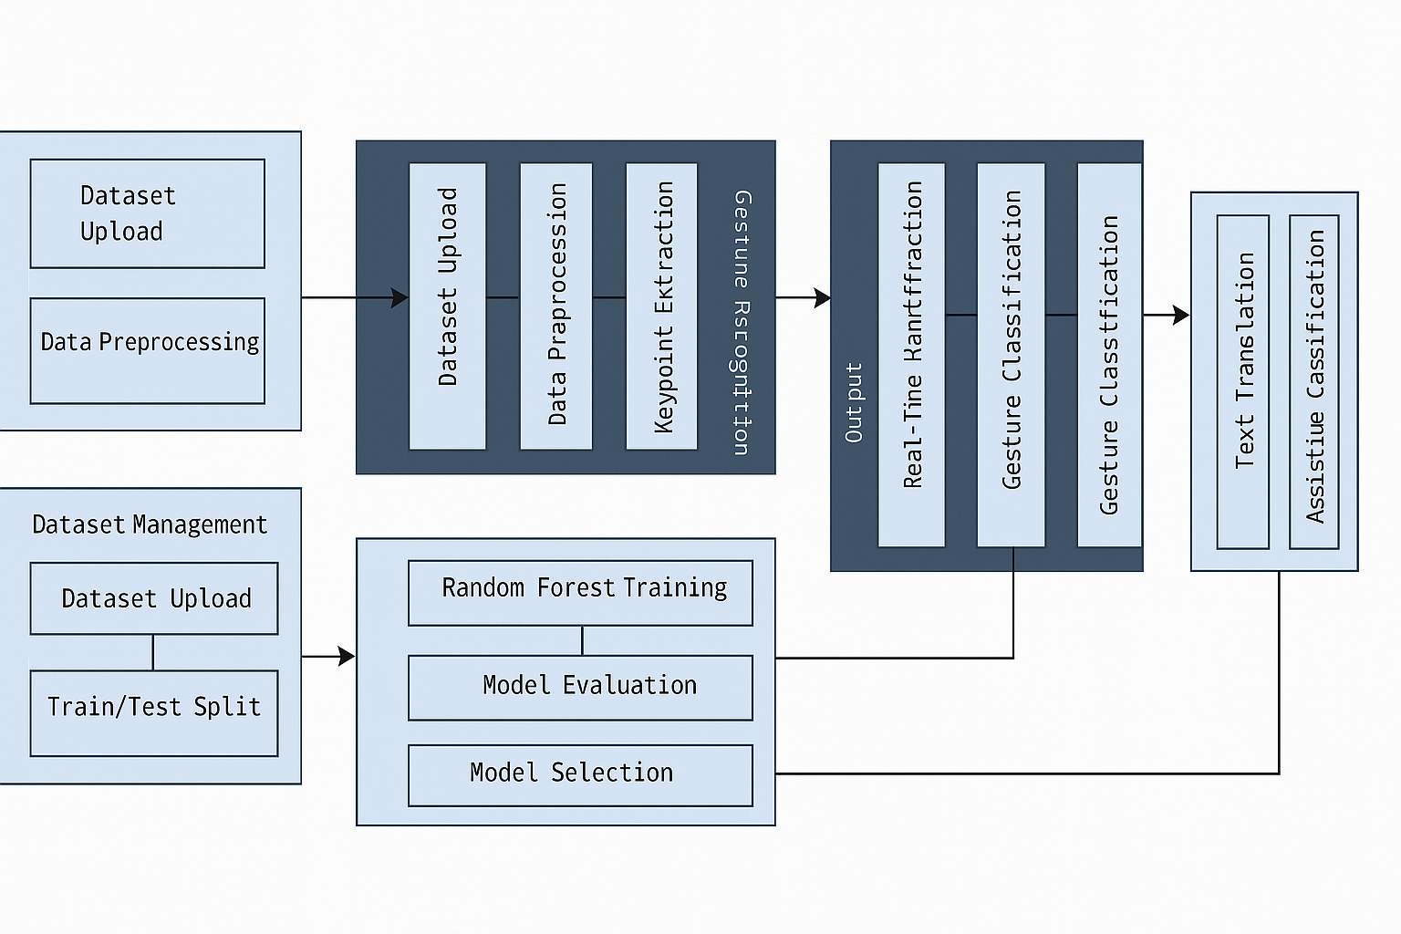
UML DIAGRAM – Data Flow Diagram

Slide 20
Software Environment Setup
Language : Python 3.7 or more
Libraries : OpenCV : for video frame handling and image processing
NumPy : for matrix and array operations
TensorFlow/Keras : to build and train the CNN model
IDE Options : Jupyter Notebook, VS Code, PyCharm
Model Saving : Trained model saved in .h5 or .pb format
Execution : Real-time prediction using live webcam feed

Slide 21
Technologies Used:
SOFTWARE ENVIRONMENT
Deep Learning (Convolutional Neural Networks - CNNs)
Learns to recognize gestures from training data
Highly accurate for image-based pattern recognition
OpenCV (Open-Source Computer Vision Library)
Handles image and video input from the camera
Performs real-time processing like resizing, color filtering, and background removal
Python Programming Language
Used for writing the code that connects OpenCV with CNN models
Easy syntax and strong support for machine learning libraries
Django Framework (Optional for Web Integration)
Used for backend if gesture control needs to trigger web-based actions
Handles user management, databases, and web interfaces

Slide 22
System Setup and Configuration:
Step 1: Install Python
Version 3.7 or above recommended
Download from python.org
Step 2: Install Required Libraries
Using pip:
pip install opencv-python tensorflow keras numpy
Step 3: Configure IDE
Use Jupyter Notebook / VS Code / PyCharm
Set project interpreter and virtual environment
Step 4: Connect Webcam
OpenCV should automatically access webcam through:
cap = cv2.VideoCapture(0)

Slide 23
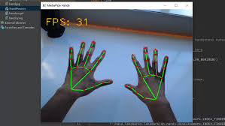
IMPLEMENTATION MODULES
Module 1 – Image Capture(Input Layer)
1. Webcam Initialization
Uses OpenCV’s cv2.VideoCapture(0) to access webcam.
Captures frames continuously in real-time.
2. Real-Time Input Handling
Captures frames per second (FPS).
Ensures a smooth, live feed for gesture recognition.
3. Frame Management
Can control resolution and orientation.
Buffers and stores the latest frame for processing.

Slide 24
IMPLEMENTATION MODULES
Module 2 – Preprocessing (Data Cleaning)
1. Frame Conversion:
Converts to grayscale or RGB for simplicity
Applies resizing (e.g., 64×64 pixels) to reduce computation
2. Noise Removal & Normalization:
Removes background clutter
Normalizes pixel values (0–1 scale)
3. Focus on Region of Interest (ROI):
Crops the hand region to improve accuracy

Slide 25
IMPLEMENTATION MODULES
Module 3 – CNN-Based Gesture Recognition
1. Model Type:
Convolutional Neural Network (CNN)
Trained on labeled gesture datasets
2. Model Training:
Uses thousands of gesture images (thumbs-up, fist, etc.)
Trained using TensorFlow/Keras
3. Prediction Output:
Outputs a label/class (e.g., "Swipe Left")
High confidence levels due to learned patterns
4. Model Format:
Saved as .h5 file and loaded at runtime

Slide 26
IMPLEMENTATION MODULES
Module 4 – Action Mapping & Execution
1. Gesture-to-Action Mapping:
Each recognized gesture is linked to a system command
2. System Response:
Could be:
Visual feedback (text, icon)
Functional output (open file, next slide)
Hardware interaction (via APIs)
3. Flexibility:
Actions are customizable
Easy to integrate into GUI or external systems

Slide 27
TESTING & VALIDATION
Goal of Testing:
Ensure the system is accurate, fast, and robust
Identify and fix errors before deployment
Testing Levels Used:
Unit Testing : Tested each function (e.g., webcam capture, model prediction)
Integration Testing : Verified data flow from webcam → OpenCV → CNN → Output
System Testing : Tested the entire gesture-to-output pipeline
User Acceptance Testing (UAT) : Confirmed system works with real user gestures
Tools Used:
Python’s unit test and manual live testing with webcam
Logging for output tracking and debugging.

Slide 28
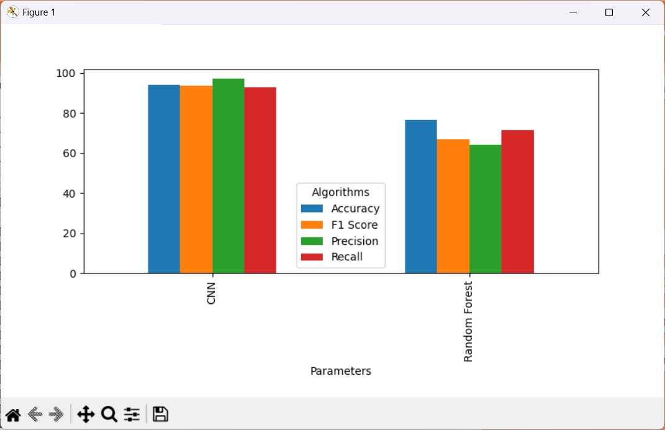

Slide 29
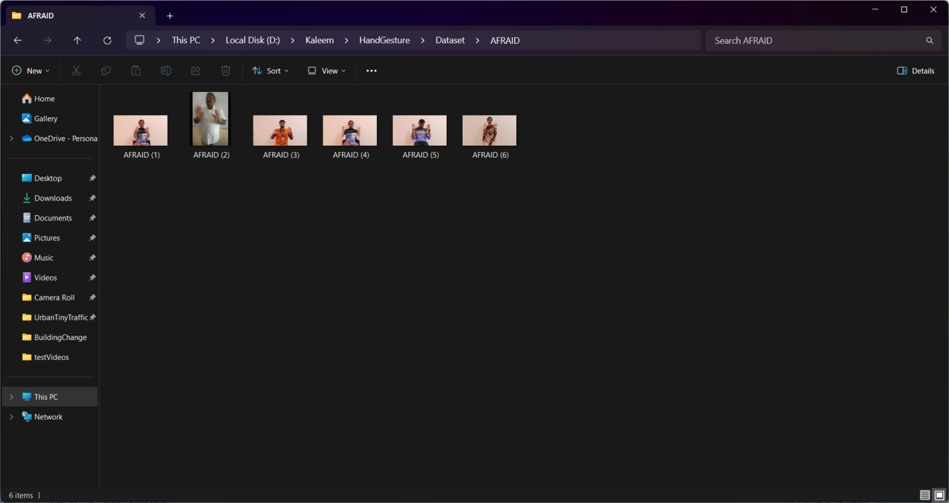
SAMPLE SCREENSHOTS

Slide 30
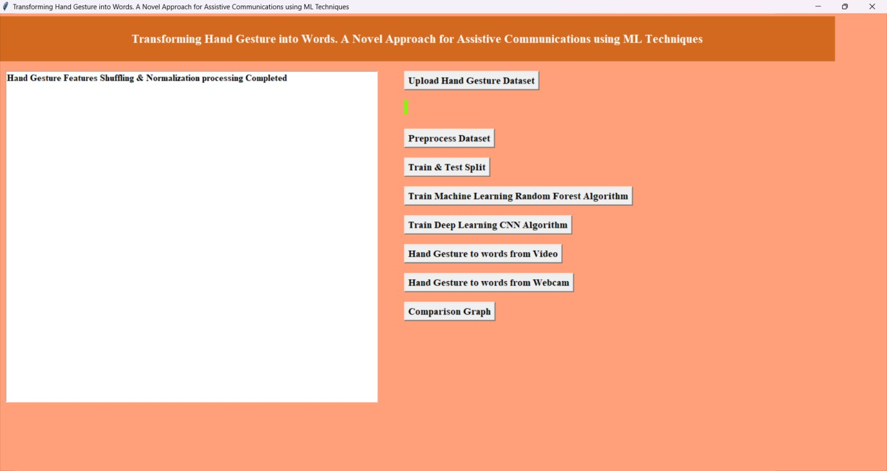

Slide 31
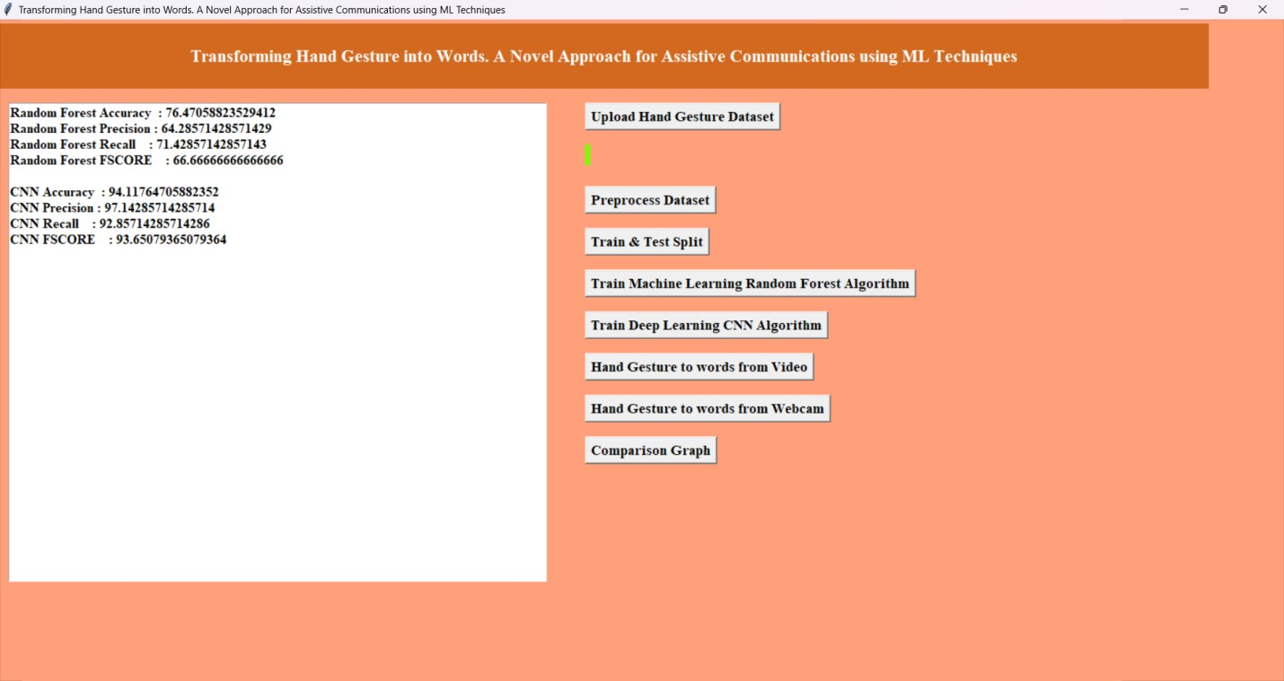

Slide 32
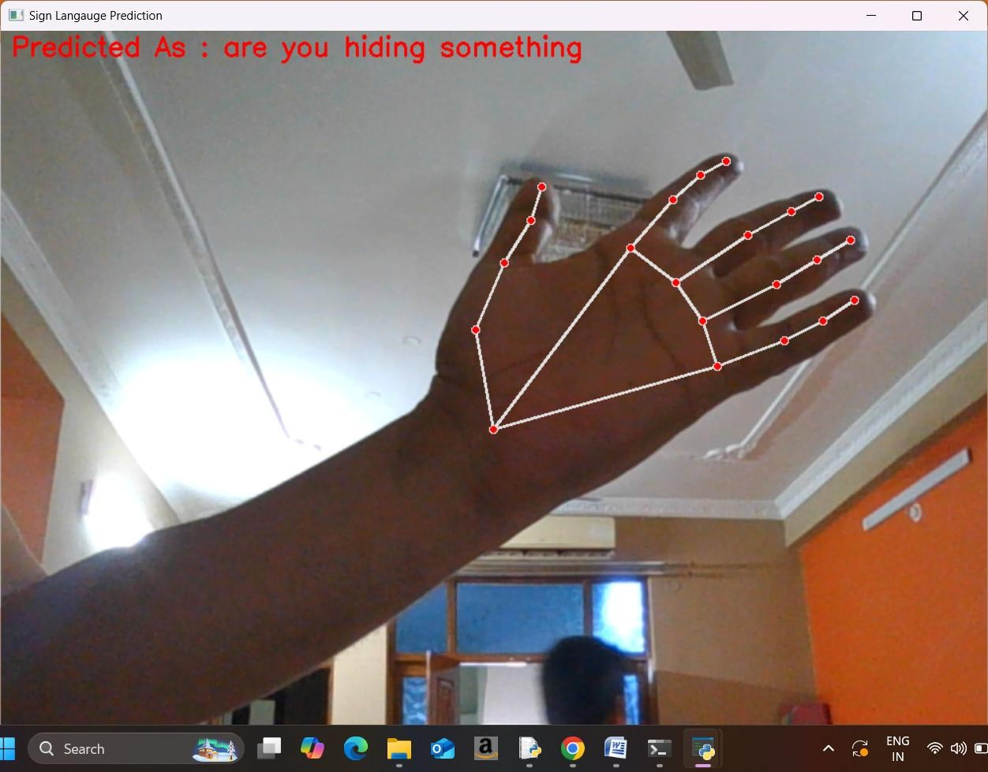

Slide 33
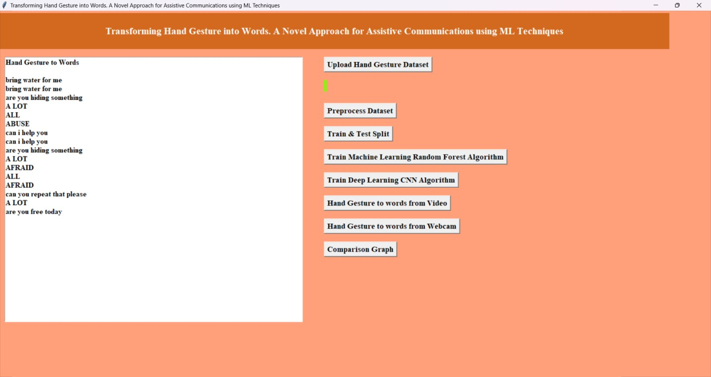

Slide 34
APPLICATIONS
1. Gaming & Virtual Reality (VR)
Control characters or actions using hand gestures
Offers immersive, controller-free experience
2. Smart Home Automation
Control lights, fans, music, and appliances with simple gestures
Helpful for elderly or physically impaired users
3. Human-Computer Interaction (HCI)
Replace mouse/keyboard with gestures
Useful in touchless public interfaces like ATMs, kiosks
4. Healthcare & Rehabilitation
Enable patients to communicate or control devices using hand signs
Helpful for people with limited mobility.

Slide 35
1. Multi-User Recognition
Extend the system to identify and track gestures from multiple users simultaneously
Useful for collaborative interfaces or multi-person applications
2. Gesture-to-Speech Conversion
Convert recognized gestures into spoken output using text-to-speech
Assistive tech for users with speech/hearing disabilities
3. Improved Accuracy with Larger Datasets
Train models on more diverse data covering:
Different skin tones
Hand sizes
Lighting/background variations
4. Mobile App Deployment
Optimize system for smartphones using TensorFlow Lite or ONNX.
FUTURE ENHANCEMENTS AND SCOPE

Slide 36
CONCLUSION
The system combines deep learning and OpenCV to enable accurate, real-time hand gesture recognition. CNNs effectively classify gestures under varying conditions, while OpenCV ensures smooth video processing. It supports touchless interaction for applications in gaming, smart homes, VR, and assistive tech, enhancing accessibility and user experience.

Slide 37


Slide 38


